Slide 1
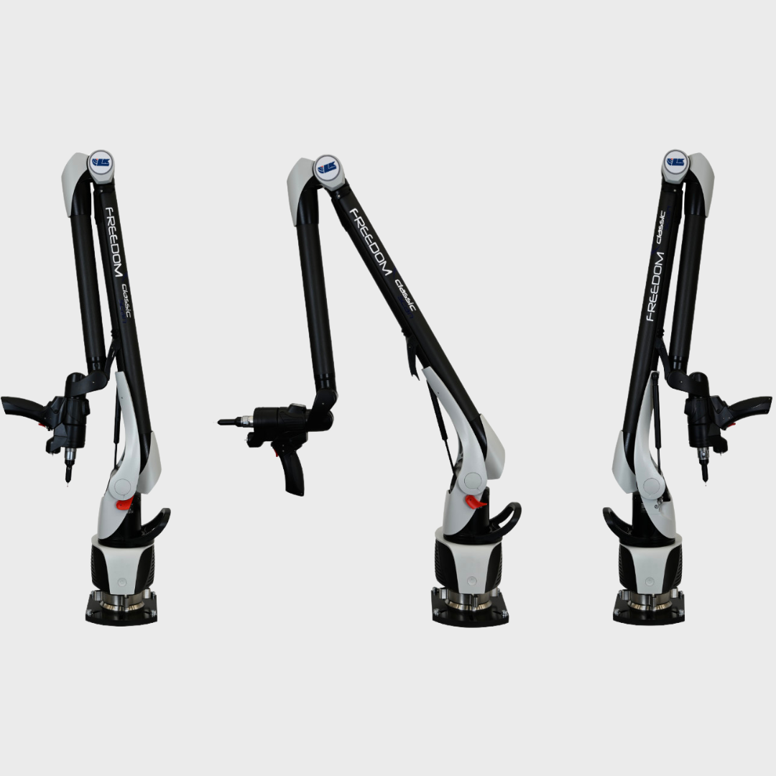
Week 7 – Progress Meeting
Overview
Functional Requirements
Concept Generation

Slide 2
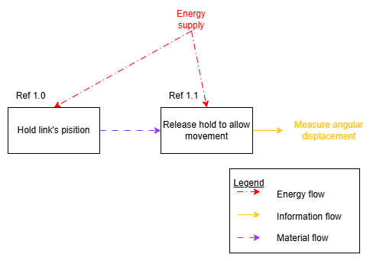
Functional Requirements
FR_01: Hold link’s position
FR_02: Release hold to allow movement
FR_03 Measure angular displacement

Slide 3
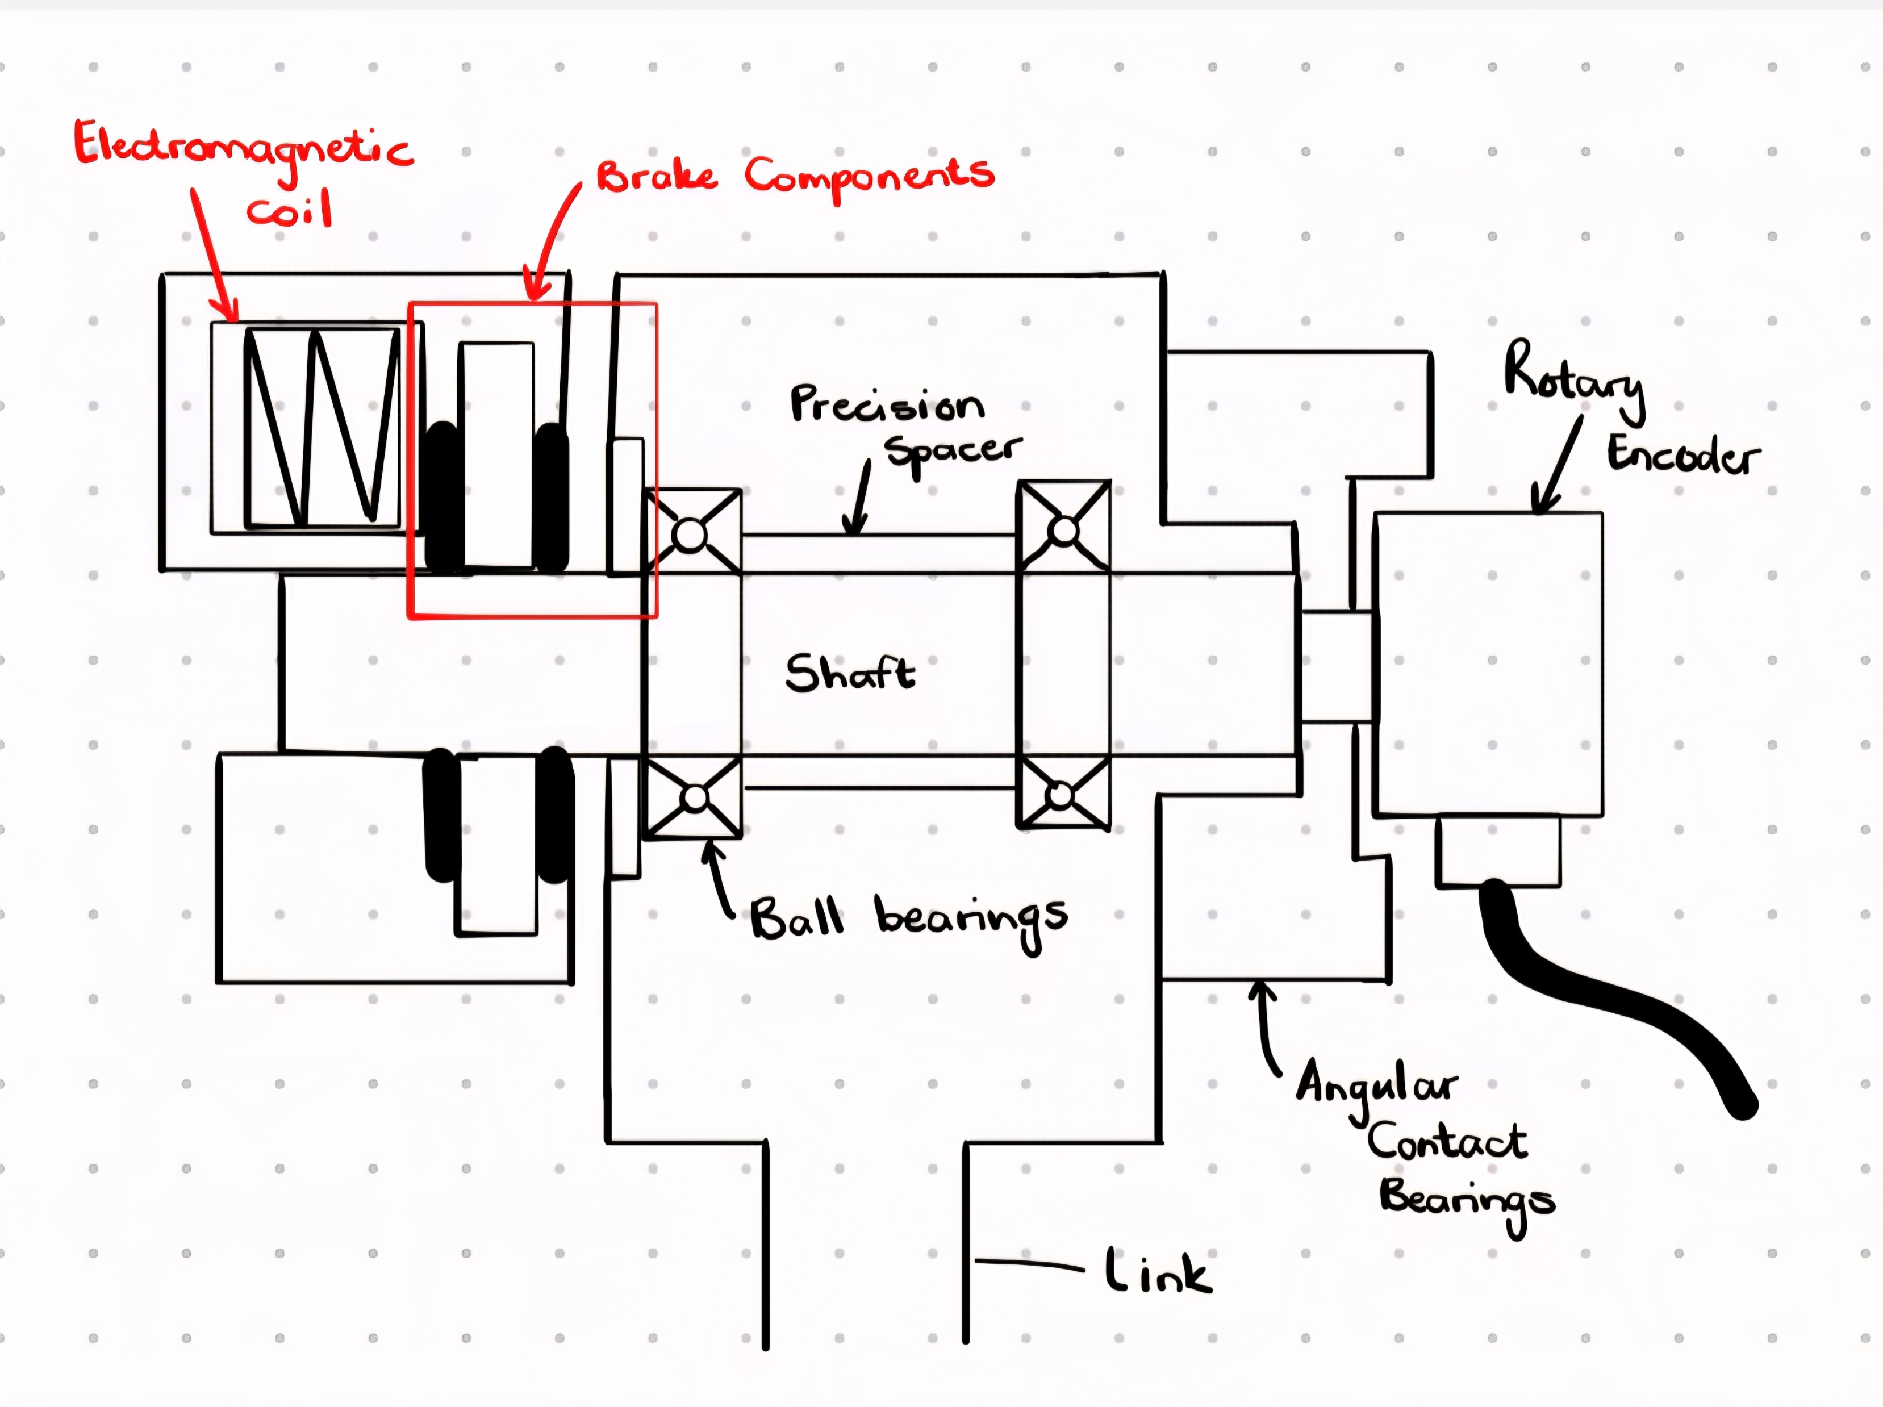
Concept : Active Brake for Revolute Joint

